Slide 2


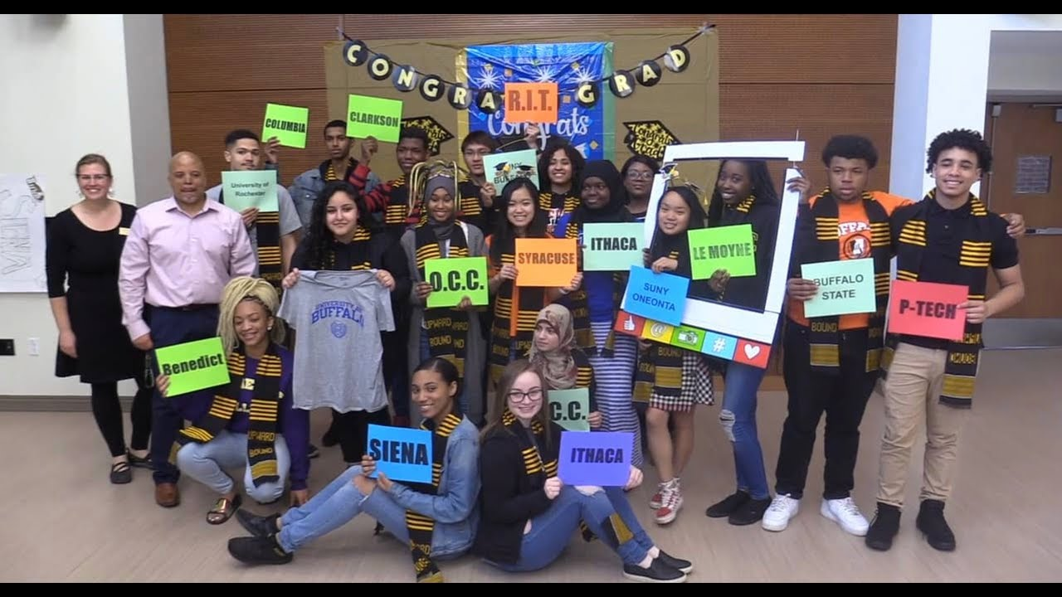

҉ Instructor/ tutor services
About The Upward Bound Program
Upward Bound is part of the overarching TRIO program in the United States, which is a federal and state grant-funded program that caters to the educational enrichment and attainment of historically disenfranchised and low-income high school students.
“Courses covered in the program include math, science, computer applications, personal growth, writing, composition, and laboratory sciences. There is an academic year (September - June) and a summer program (June - August)” (Le Moyne College Upward Bound Program).
Services Provided
҉ Instructor/ tutor services
Mentoring
Work-study opportunities
College Prep
Financial Advising
Counselling

Slide 3

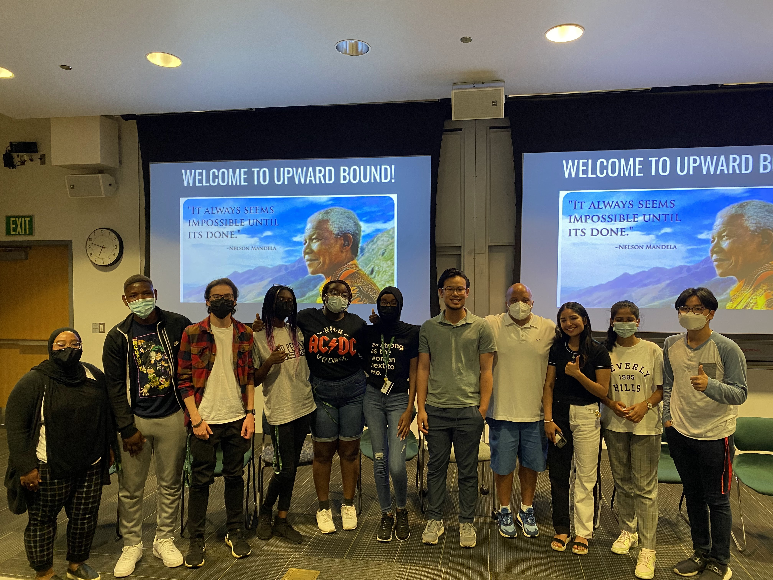
Why Look At The Upward Bound Program & Its Retention Rate?
Variables Used For Analysis
Zip code
Participation Years
Six cohorts
Gender
Youth Gang Violence
Income
Poverty
Education Attainment
Based on the findings, the question spans out to how can the Upward Bound program strategically and effectively recruit and retain its students, especially male students.
There has been a growing gap between enrollment and retention rates of males in the educational sector.
Due to this issue, more young men are high targets for gang recruitment or are unable to progress to socio-economically.
- Recruitment of male students based on zip code. So, which city high schools do they have the least enrollment?
-Conducting surveys on what could potentially stop their students from attending, and how to prevent it.

Slide 4
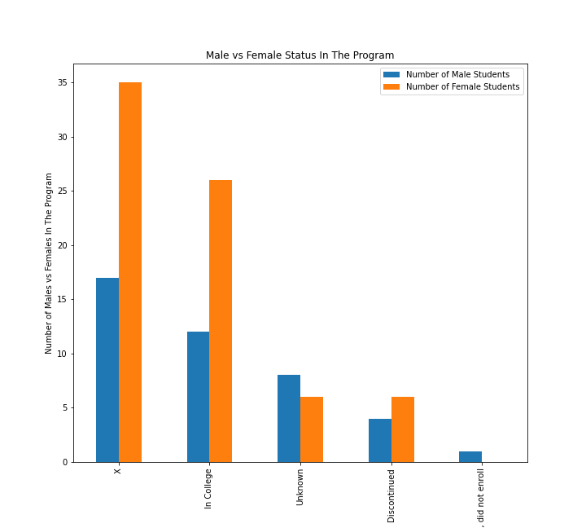
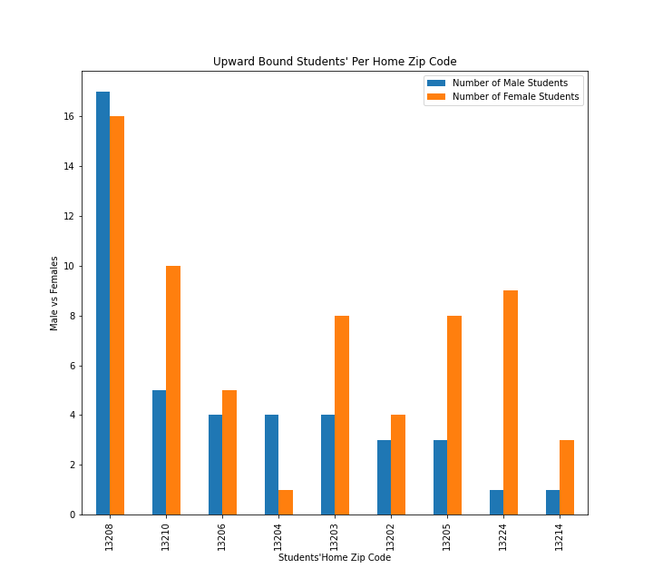
Students Per Zip Code & Upward Bound Participation Status

Slide 5
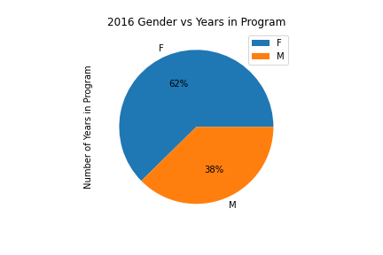
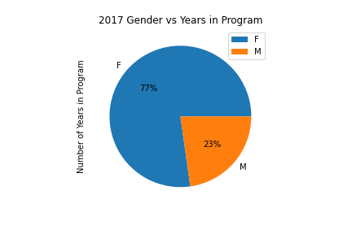
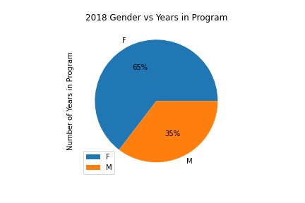
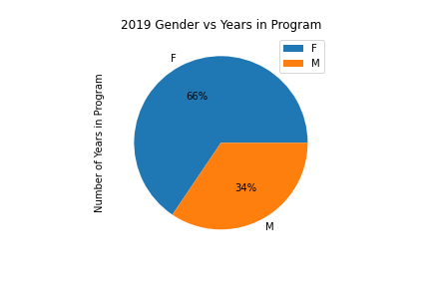

Cohorts Aggregated Overtime | 2016 - 2020

Slide 6
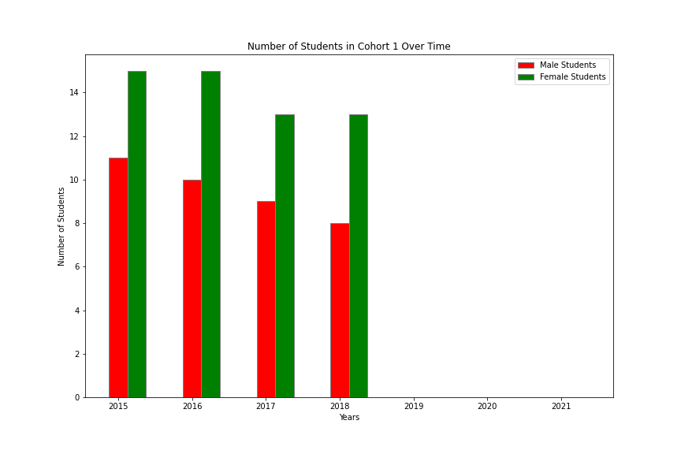
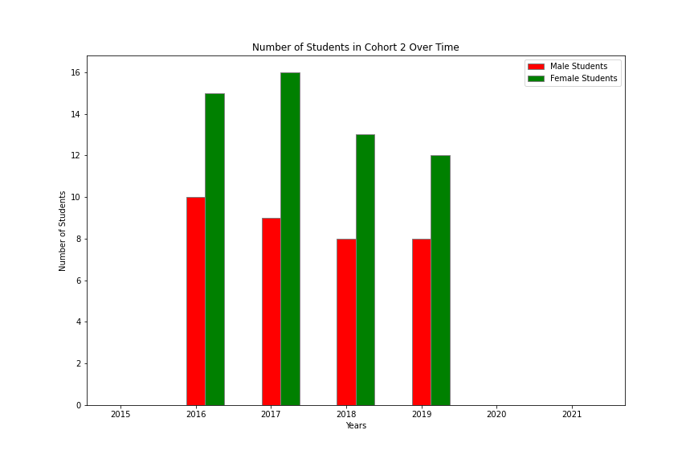
Cohorts Shown Individually Overtime | 2016 - 2020

Slide 7
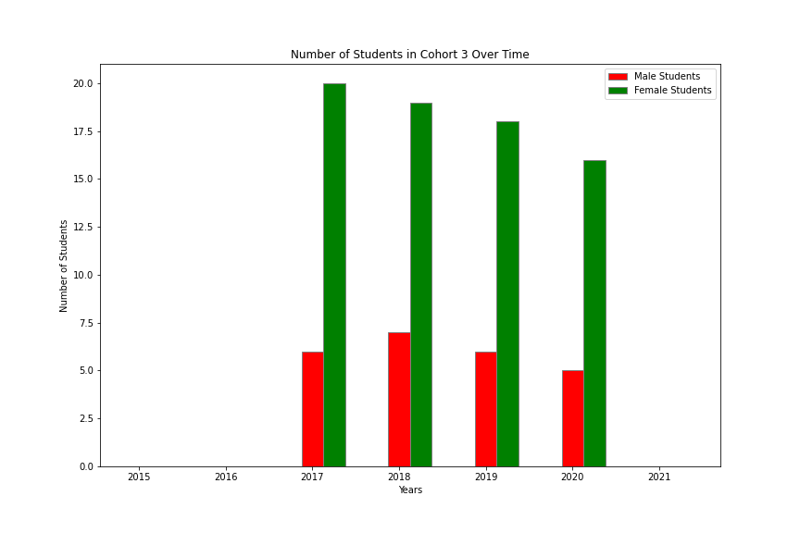
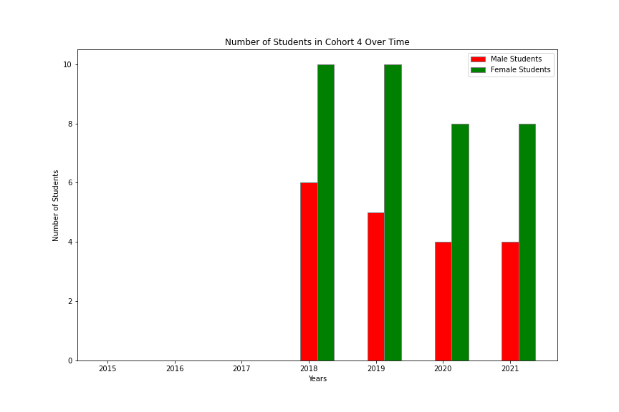
Contd. Cohorts Shown Individually Overtime | 2016 - 2020

Slide 8
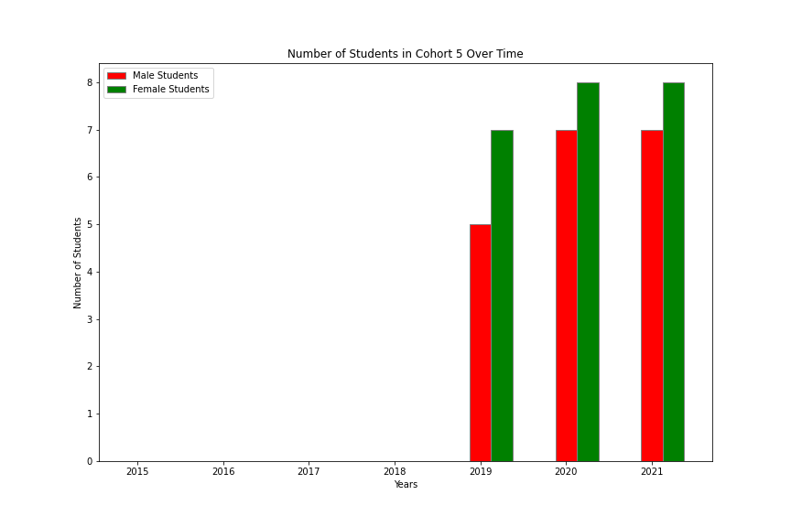
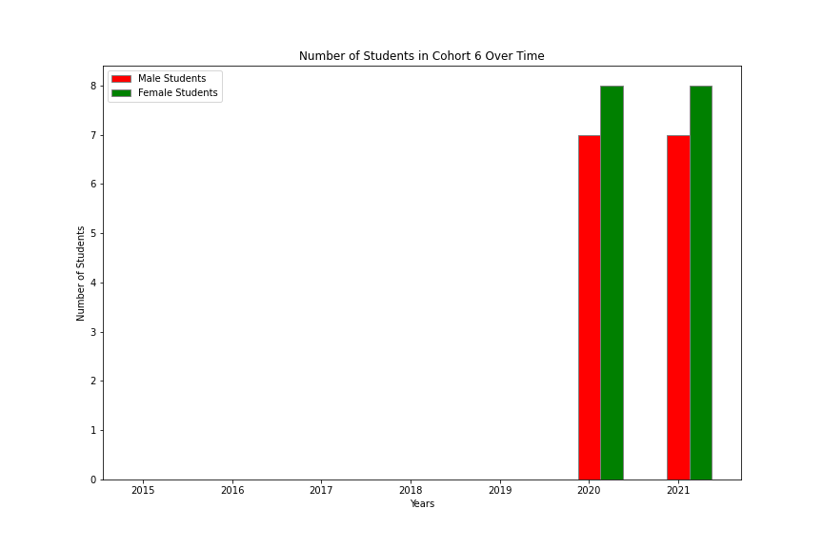
Contd. Cohorts Shown Individually Overtime | 2016 - 2020

Slide 9
THANK YOU!
If interested, more information and analysis will be available on May 10th.

